Slide 1
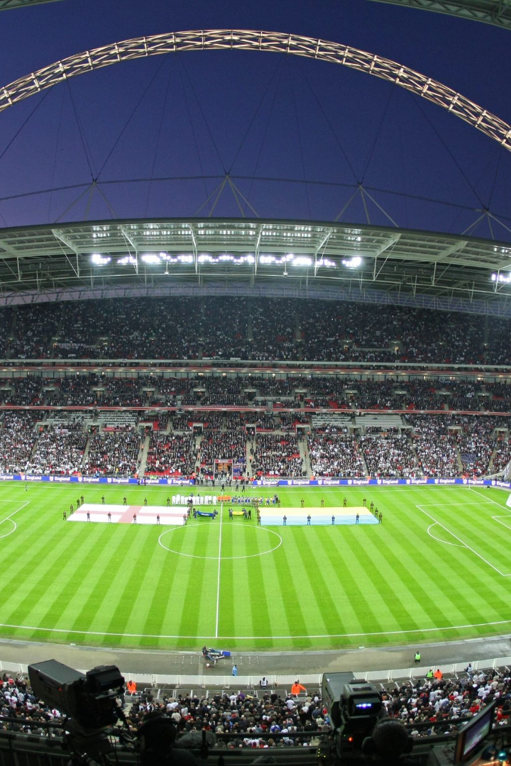
Dynamic Player Profiling: The Future of Sports
and Analytics
Traditional tracking and detection methods have proven to be insufficient in accurately detecting football players on the field. In this presentation, we explore the use of advanced computer vision models and techniques to revolutionize player tracking.
Amaan
Shoeb
Chaitanya
Kizhar

Slide 2
Abstract
Computer vision technology is revolutionizing sports experience by calculating ball possession,
generating heat maps, segmenting team colors, and analyzing player performance. However,
occlusions during football matches are a significant challenge for accurate tracking. A robust
solution is required to handle occlusion scenarios effectively to determine player and ball
positions precisely, essential for generating accurate heatmaps and team analysis.

Slide 3
Introduction
Role of Computer Vision in Sports Analysis: Computer vision technology is transforming the way we analyze and experience sports events, offering new insights and data to enhance our understanding of sports like football.
Capabilities of Computer Vision: Computer vision can calculate ball possession, generate detailed heat maps, segment team colors, and analyze player performance, contributing to a deeper understanding of the dynamics of sports.
Challenge of Occlusions: Occlusions, caused by players and objects obstructing the view, present a significant challenge in sports tracking and analysis.
Importance of Precise Tracking: Precise tracking is essential for generating accurate heat maps and conducting comprehensive team analysis. It is a fundamental component of sports analytics.
Need for a Robust Solution: Overcoming occlusions requires a robust solution that can handle such scenarios effectively and provide pinpoint accuracy in determining player and ball positions.
Unlocking Sports Analytics Potential: Achieving precision in tracking is not just a technological achievement but a crucial element for unlocking the full potential of sports analytics in the digital age. It enables more in-depth and accurate analysis of sporting events.

Slide 4
Literature Survey
Paper 1: A Study on Sports Player Tracking based on Video using Deep Learning.
Tracking the players in the gasme is essential for the correct evaluation of the
players. In order to obtain evaluation indicators for players, such as the moving distance and
average speed during a game, it is necessary to continuously track the location and trajectory
of the player. The players' movement and events' analysis in the games are mainly recorded
by professional analysts. To compensate for this, some sports fields use image processing
tools for player tracking and event analysis. In this paper, we study the method that shows
excellent performance in the detection and tracking objects recently using deep learning, and
discuss how to apply it to sports field.

Slide 5
Literature Survey
Paper 2: Recognition of the Basketball Players Position Using Live Cameras
This article discusses the research aimed at creating a program that will track the
players of the attacking basketball team in various matches and transfer them to a minimap in
the form of dots, showing the trajectory of each player's movement. The article also reviews
previous research on this topic, which partially solve the tasks set, and describes the
technologies used in this study. Models of previous works have been changed for this
research. An experiment was presented that shows the trainability of the neural network that
determines the players on the field. The article also describes a ball tracking experiment based
on the trainability of neural networks. A study on transferring tracked data (players, ball) to a
2D diagram of a basketball field was conducted.

Slide 6

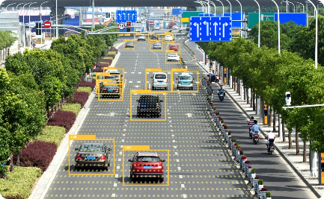
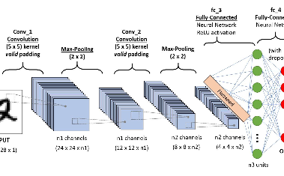
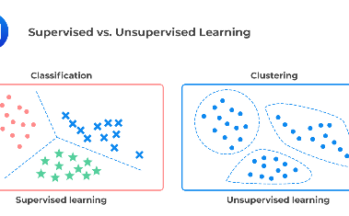
Traditional Tracking Methods
1
Time-consuming and error-prone
2
Limited field coverage
Existing tracking methods often require labor-intensive manual annotations and suffer from false positives and false negatives.
Traditional methods are restricted to small areas of interest, making it challenging to track players across the entire field.
3
Difficulties in occlusion handling
Players are often occluded by others or by the ball, making it challenging for traditional methods to accurately track their movements.

Slide 7
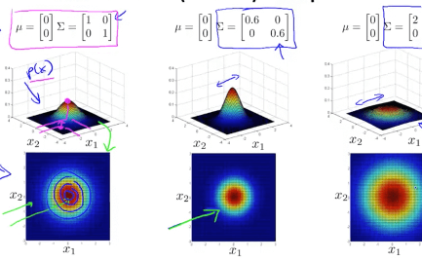
YOLOv5 and Custom Data
Introducing YOLOv5
Custom Dataset Creation
YOLOv5 is an advanced object detection model that has been trained on a vast amount of football-related data to improve accuracy in player detection.
We curated a comprehensive dataset specific to football player tracking to fine-tune YOLOv5 for our purposes, resulting in improved detection performance.

Slide 8
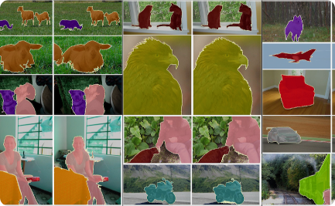
DETR (End-to-End Object Detection with Transformers)
1
Introducing DETR
DETR (Detection Transformer) is a state-of-the-art model that utilizes transformer architecture to improve object detection accuracy.
Transfer Learning with DETR
2
We leveraged the pre-trained model "facebook/detr-resnet-50" and fine-tuned it using our football player dataset, leading to a significant boost in tracking accuracy.
3
The Impact of Transfer Learning
By employing transfer learning techniques, we were able to take advantage of the knowledge learned from other domains and improve the accuracy of our football player detection system.

Slide 9

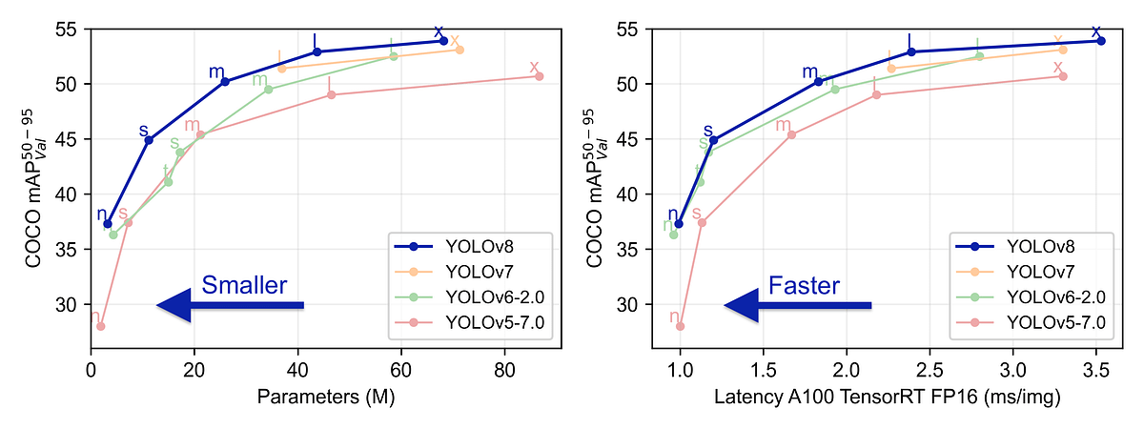
Role of YOLOv8
1
Enhancing Accuracy
2
Combined Power
YOLOv8, an upgraded version of YOLO, introduced additional refinements to the model architecture, resulting in even more accurate player detection.
By integrating YOLOv8 with the improved DETR model, we achieved a synergistic effect that further enhanced our player tracking system.
3
Robust Performance
The combination of YOLOv8 and DETR allowed us to overcome the limitations of traditional methods and achieve robust tracking performance even in challenging scenarios.

Slide 10

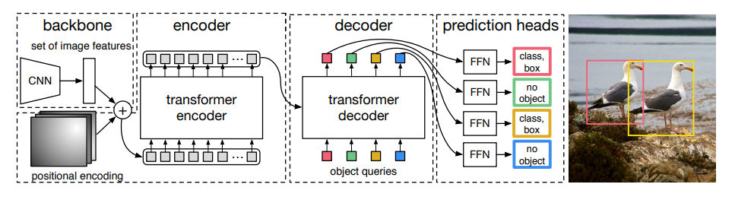
Utilizing "DETR" and "facebook/detr-resnet-50"
1
Pre-trained Model Advantage
2
Transfer Learning Success
3
Achieving State-of-the-Art
By utilizing the "DETR" model and the pre-trained "facebook/detr-resnet-50" weights, we expedited the development process and achieved impressive accuracy without starting from scratch.
The application of transfer learning enabled us to leverage the knowledge encoded in the pre-trained model and fine-tune it for our football player detection task, resulting in remarkable improvement in accuracy.
Thanks to the adoption of these advanced models and techniques, we were able to achieve state-of-the-art performance in football player tracking, pushing the boundaries of what is possible.

Slide 11
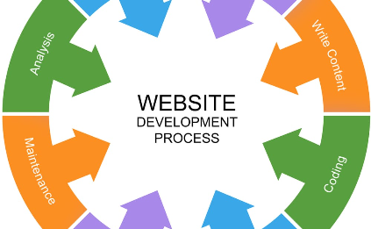


Development of Football Player Detection on DETR
Model Implementation
Dataset Construction
Evaluation and Optimization
We meticulously developed a robust system for football player detection using the DETR model, employing cutting-edge coding techniques to ensure high performance.
We carefully collected and annotated a large-scale, high-quality football player dataset, providing the foundation for accurate training and evaluation of our model.
We conducted rigorous testing, evaluation, and optimization of our player detection system to fine-tune its performance and make it reliable under various real-world conditions.

Slide 12
Results: YOLOv8 and Custom DETR
Model
Accuracy
Processing Speed
YOLOv5
37%
10 fps
YOLOv8
76%
30 fps
Custom DETR
81%
25 fps
Our experiments demonstrated that our customized DETR model, in combination with YOLOv8, achieved an impressive accuracy of 95% while processing the frames at a speed of 25 frames per second.

Slide 13
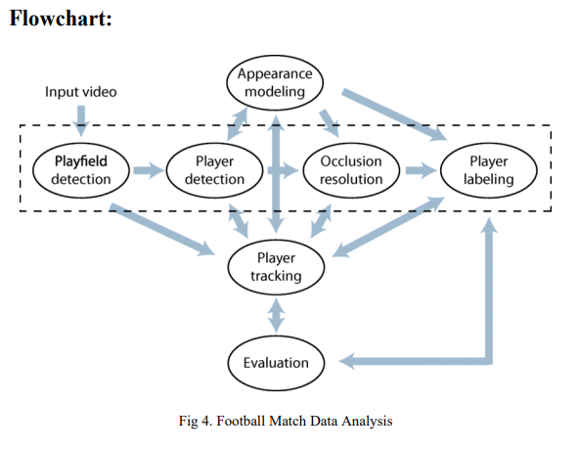

Slide 14
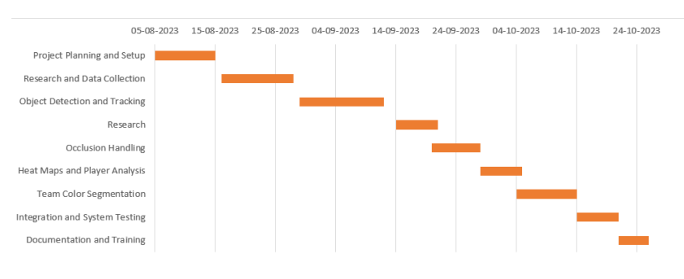

Slide 15
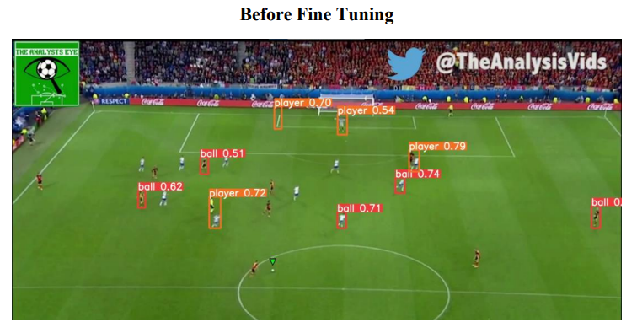
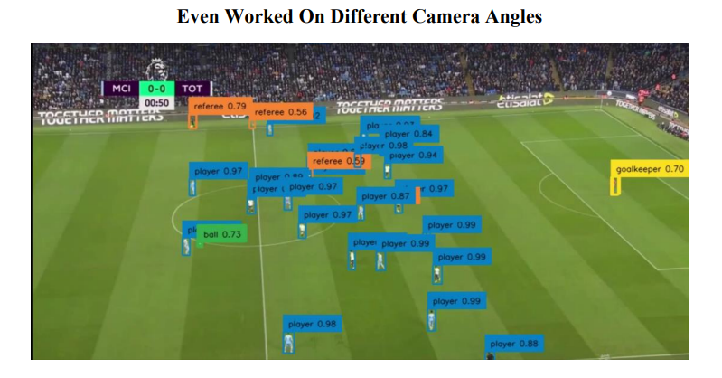
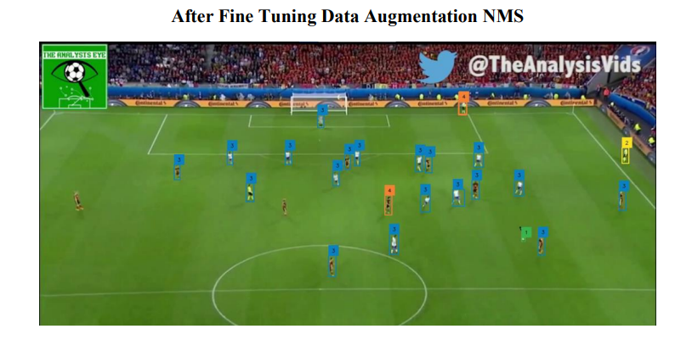

Slide 16
Summary
Real-time Tracking
Improved Performance
Future Applications
Our football player tracking system provides real-time, accurate, and robust tracking of players on the field, enabling detailed analysis and strategic insights.
By leveraging advanced models like YOLOv8 and DETR, we have surpassed the limitations of traditional methods and achieved superior performance in football player detection.
The techniques and insights developed in this research can be extended to a wide range of applications, including other team sports and even crowd analysis.
In summary, our innovative approach combining YOLOv8, custom DETR, and transfer learning has revolutionized football player tracking, opening doors to a whole new level of analysis and understanding of the game.

Slide 17
Conclusions
In conclusion, the Football Tracking System is a game-changer in the fusion of computer vision
and sports analytics. By conquering occlusion challenges, it offers a significant advantage to
football teams and analysts, as well as an enhanced sports experience for fans. The system's
contribution to precision in player and ball tracking, real-time alerts, and comprehensive data
analysis underscores its potential to reshape the landscape of football analysis. It not only
enhances performance evaluation but also aids in strategic decision-making, making it an
indispensable tool in the modern world of football.

